Slide 1
Storyboard - Smart Support
Submitted by :Group-13 (21f1003002, 21f1003442, 21f1003481)

Slide 2
A student is facing a problem with her course and wants to contact the support team. She accesses the support ticketing system through the university website.

Slide 3
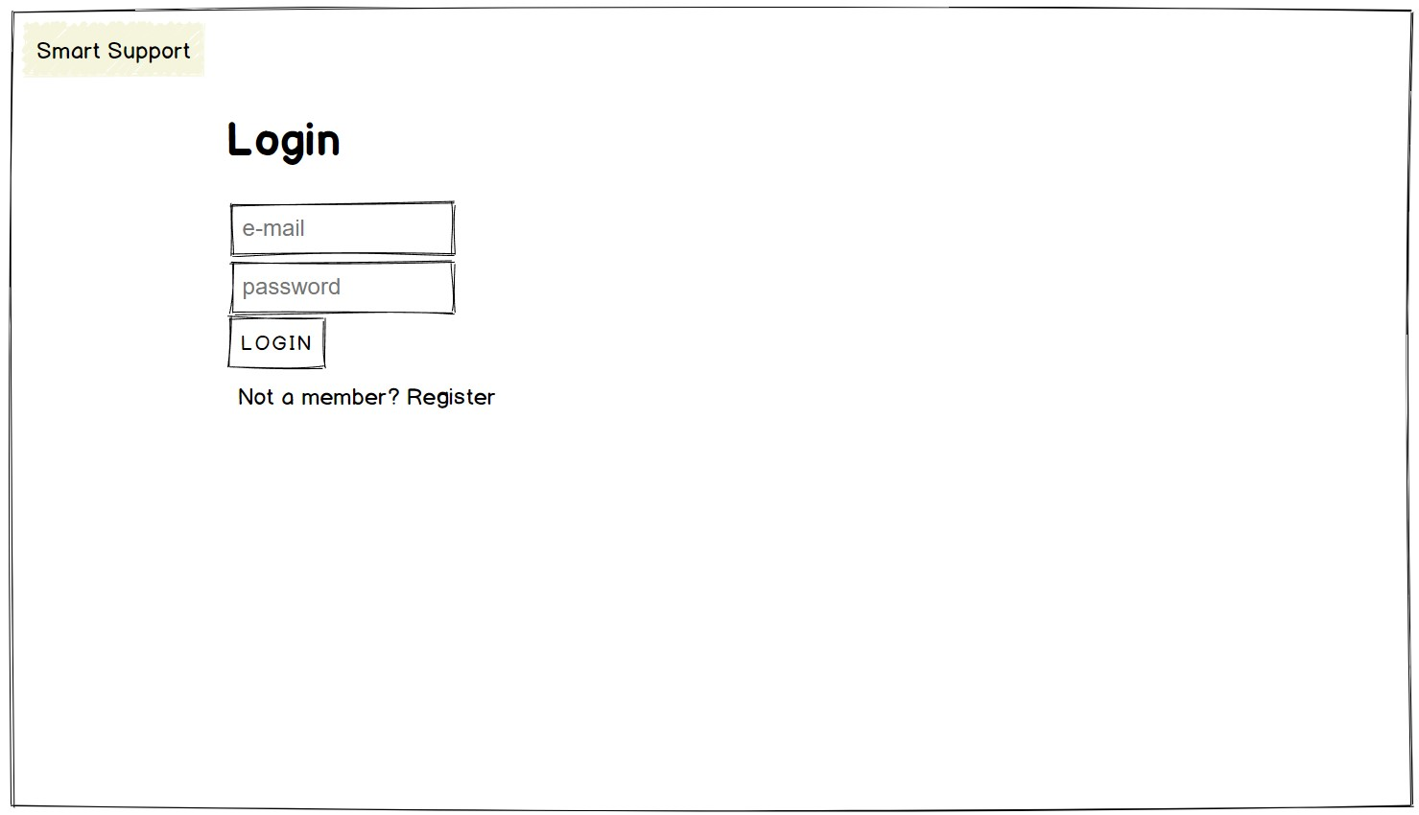
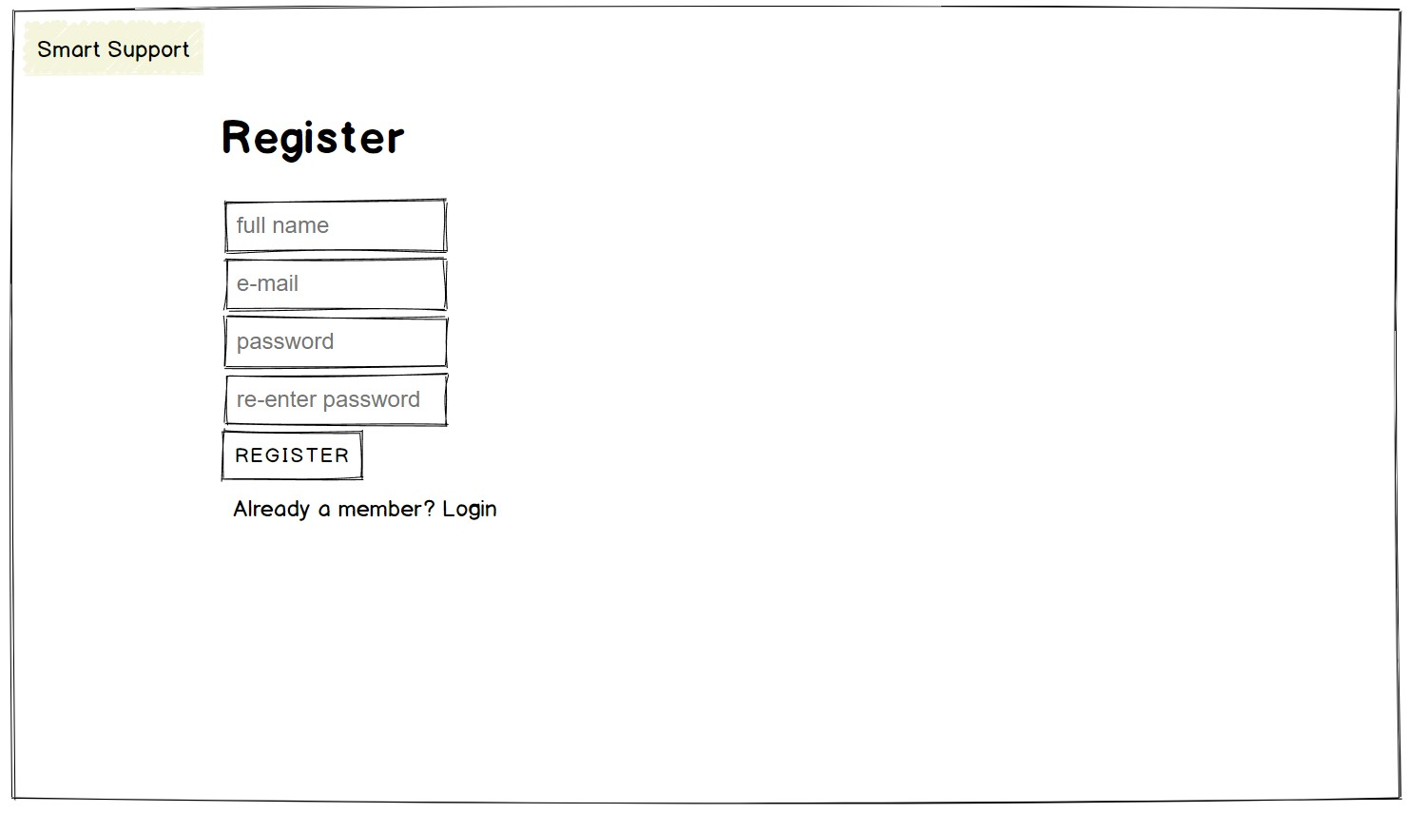
The student is presented with a login page where she needs to enter her credentials to access the support ticketing system. She can also click on Register link if she is new to the system.

Slide 4
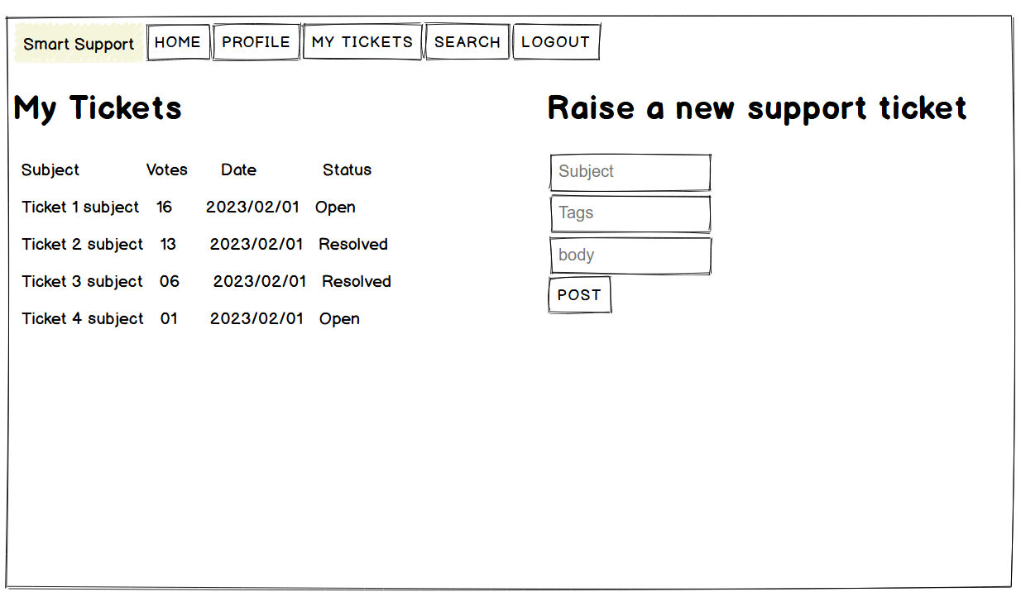
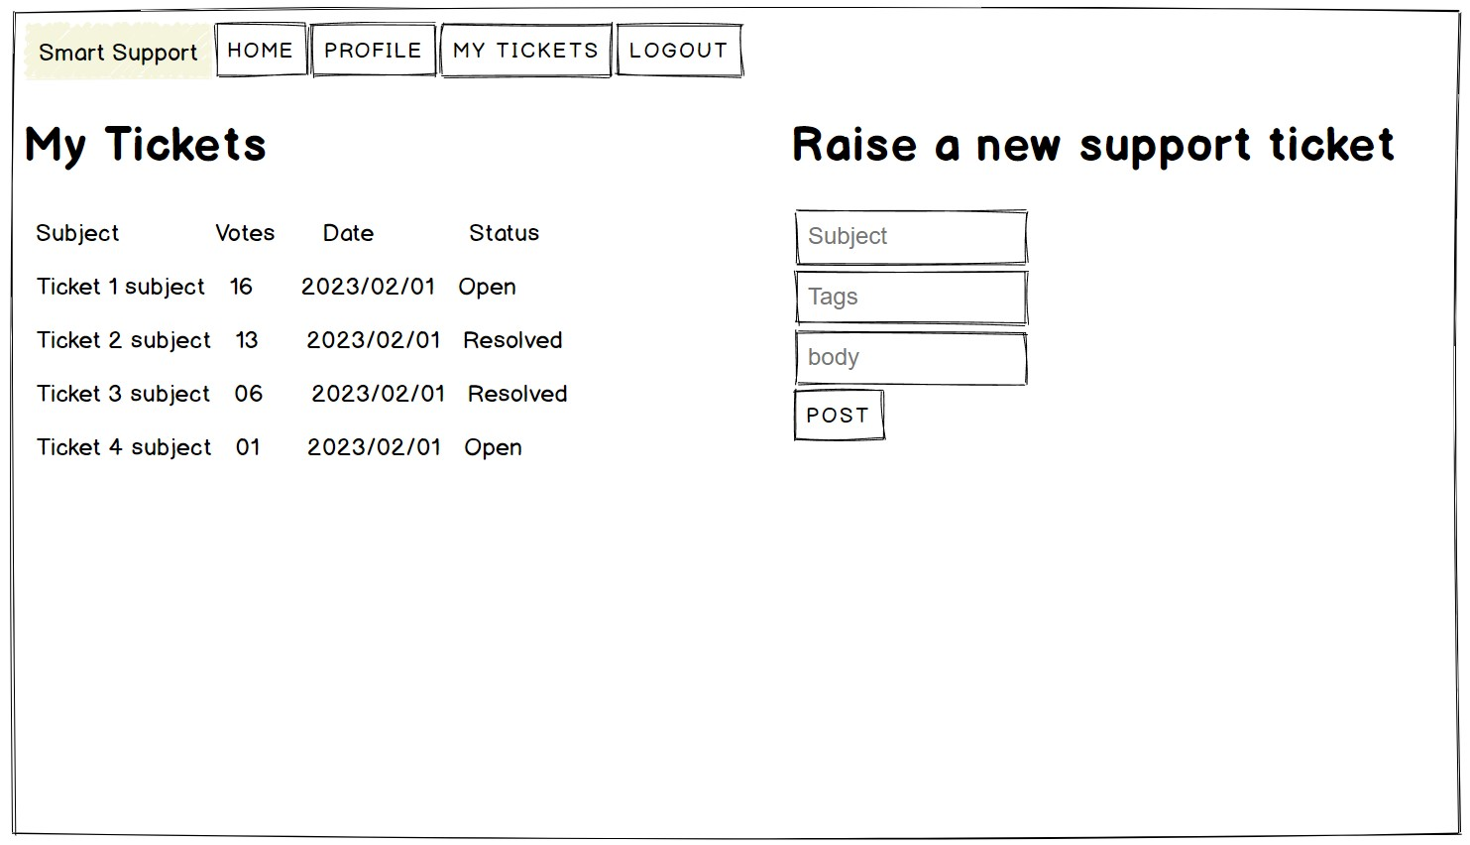
After logging in, the student is directed to the home page of the support ticketing system where she can create a new ticket or view her existing tickets.

Slide 5
In Raise a new support ticket form she can enter the details of her query or concern.
The system automatically checks if there are any similar tickets already created by other students.
If there are other similar tickets, the system displays the existing tickets to the student and prompts them to check if their concern has already been addressed.
She can also upvote an existing ticket.

Slide 6
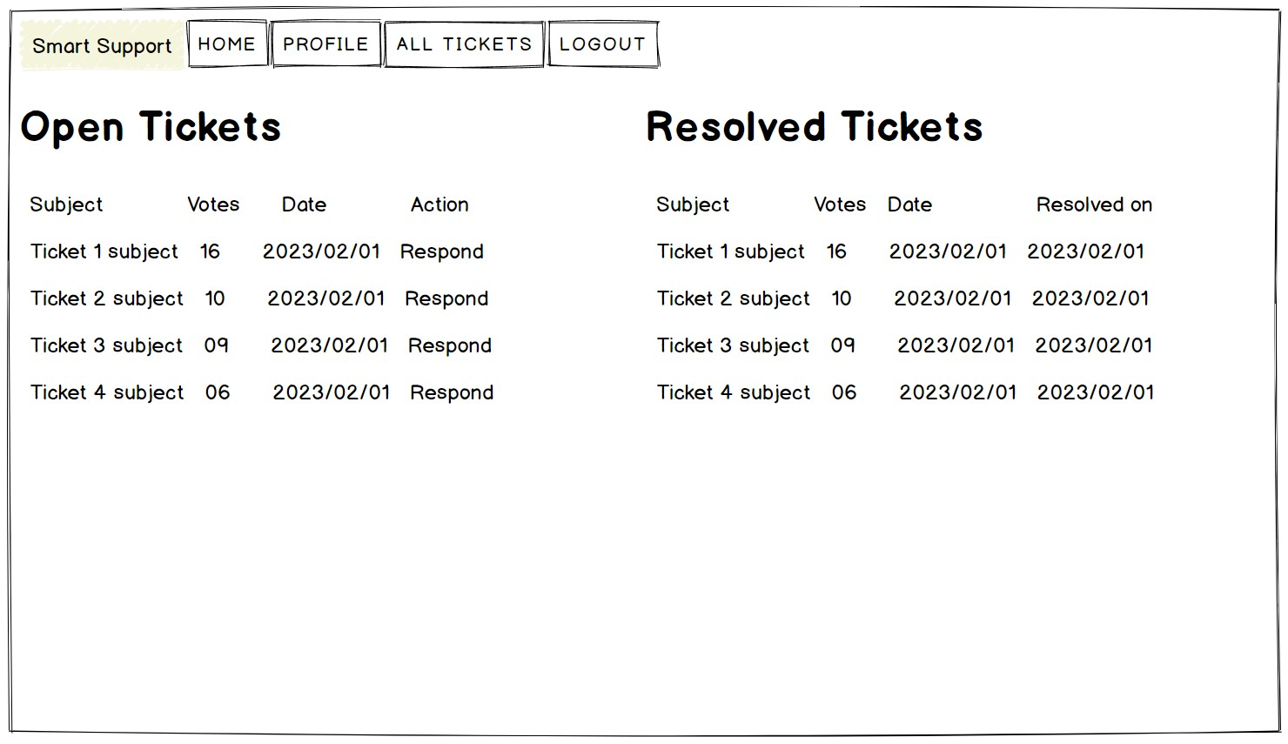
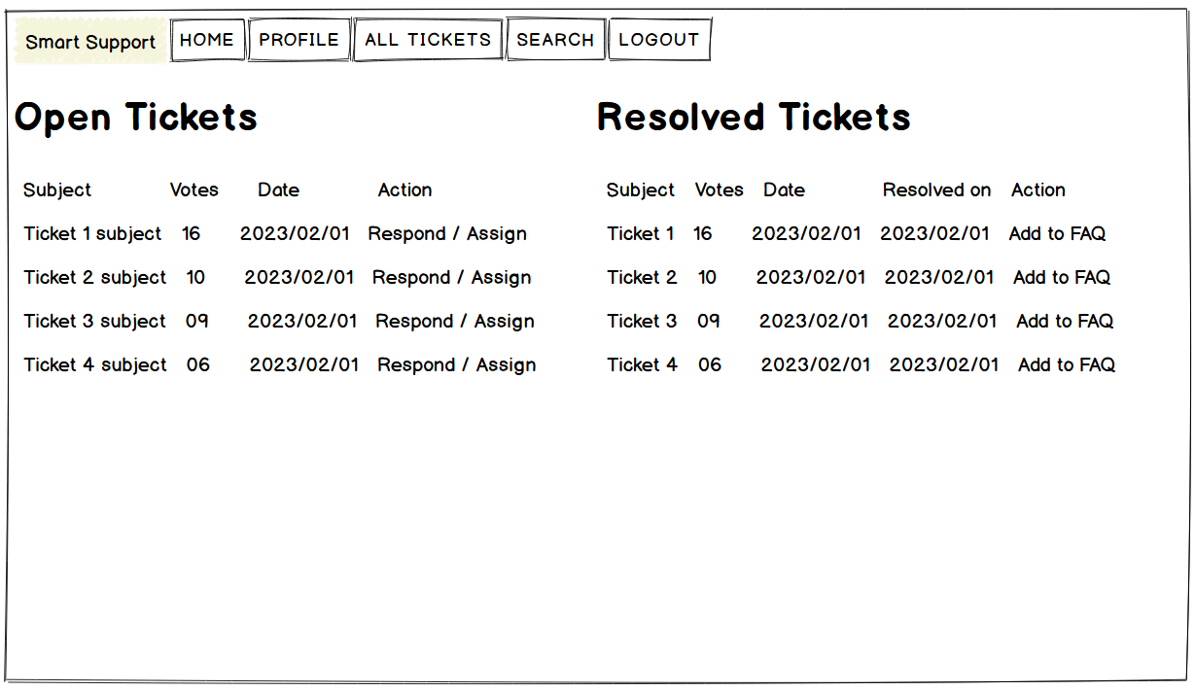
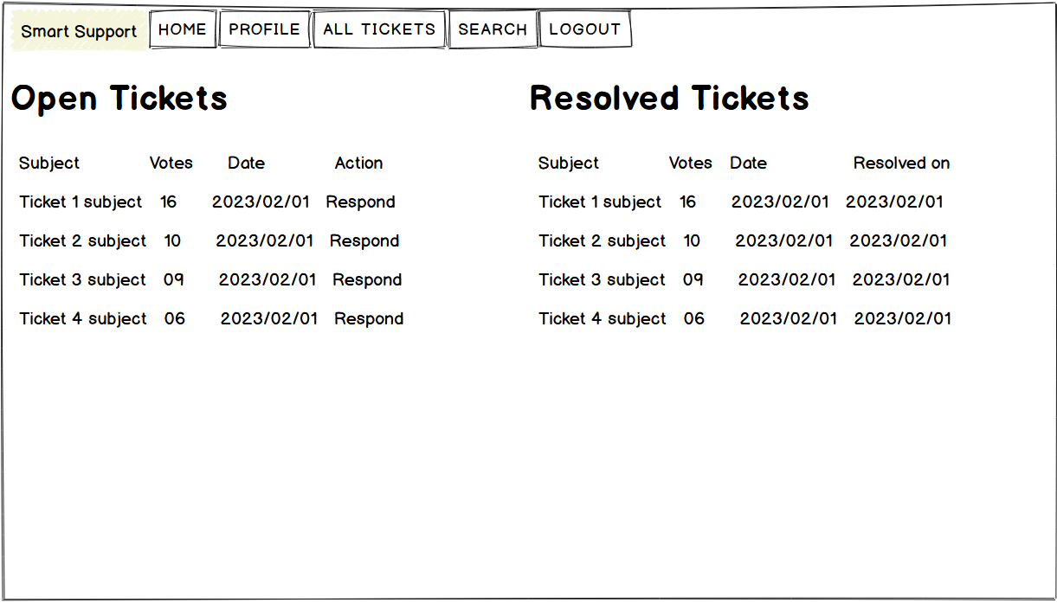
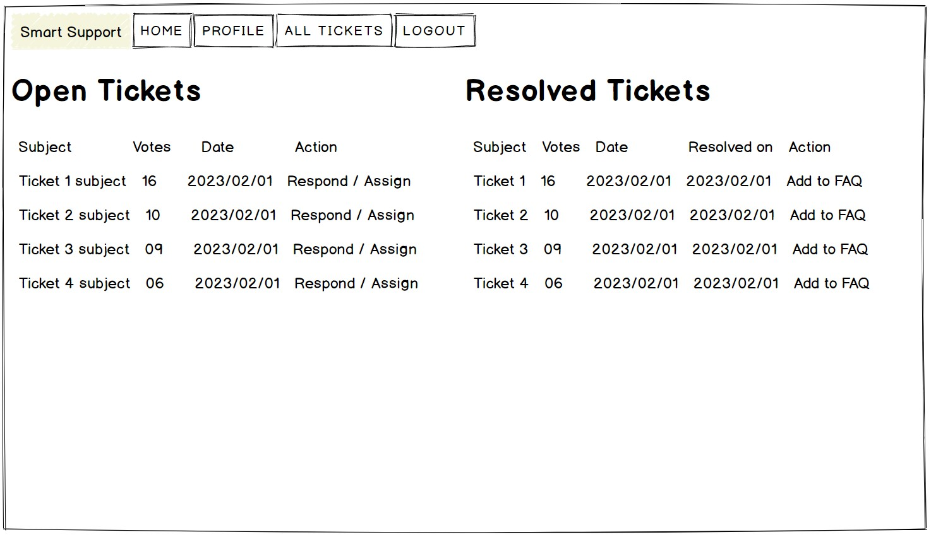
Support Dashboard
Admin Dashboard
The system updates the ticket with the number of upvotes it has received and displays the most popular tickets at the top of the list on support and admin dashboards.

Slide 7
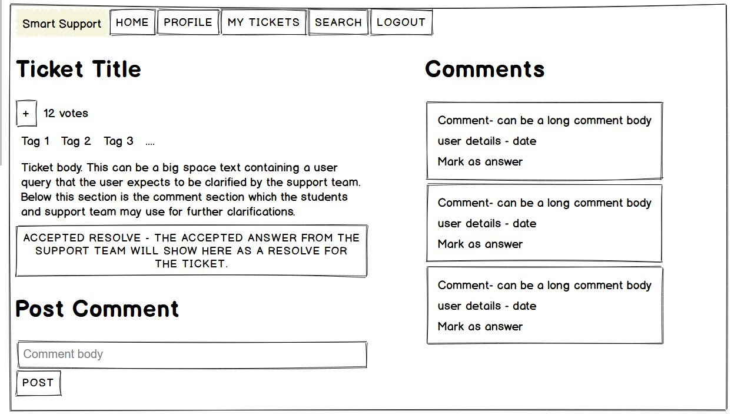
If the student decides to add a comment to the existing ticket instead of creating a new one, she can do so by visiting the relevant Ticket page

Slide 8
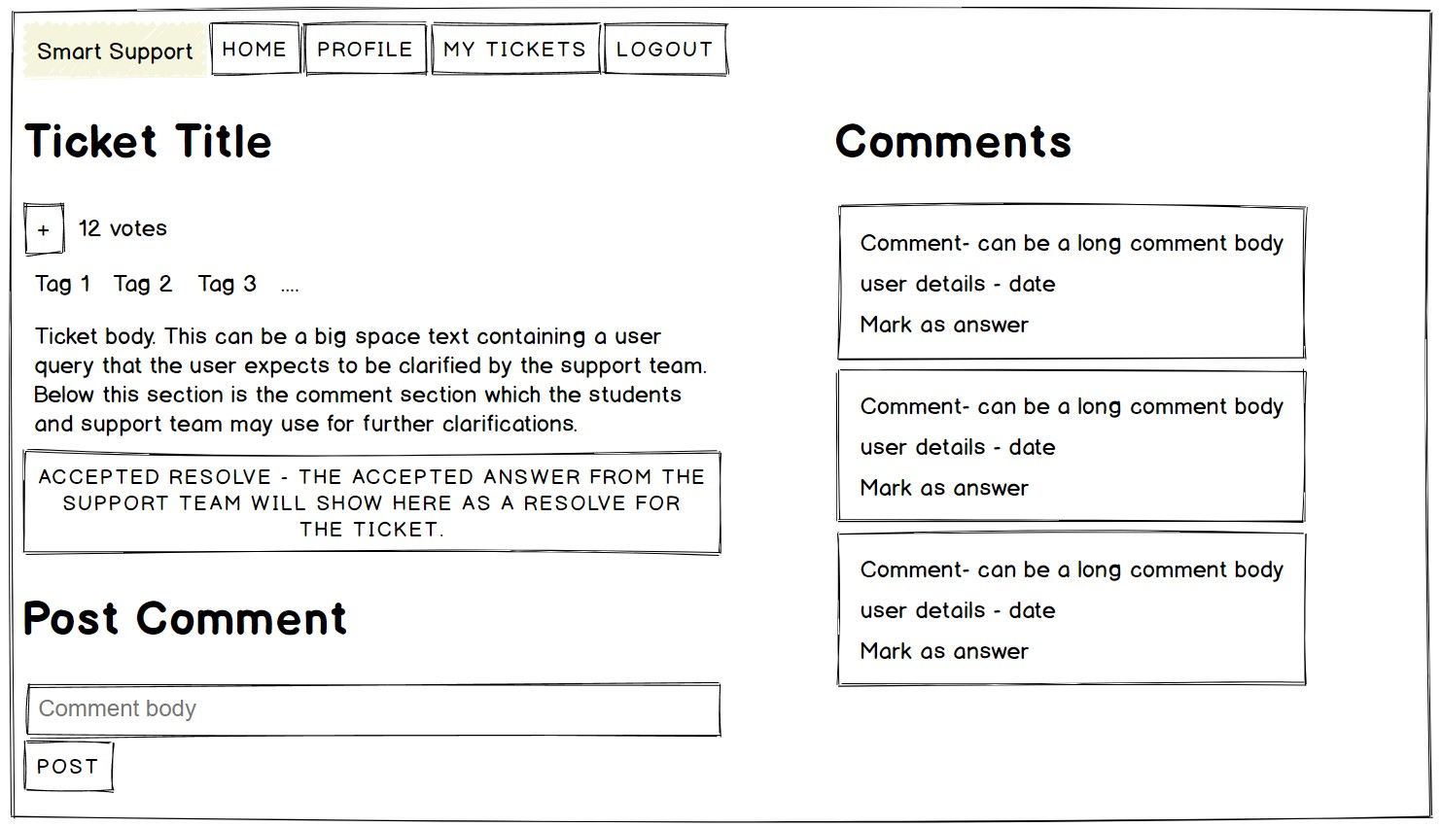
Support Dashboard
Ticket Page
The support team receives the ticket and begins working on a solution.
They can view the ticket, add comments, and update the ticket status as they work on the issue.

Slide 9
Student Dashboard
Once the support team resolves the issue, they update the ticket status to Resolved and notify the student.
The student receives a notification about the updated status of the ticket and can view the solution provided by the support team.
The status of ticket changes from Open to Resolved on the Student Dashboard

Slide 10
Admin Dashboard
Admins can see the list of all Open and Resolved tickets on their dashboard sorted by upvotes and date.
They can assign the tickets to specific support users or they can respond to the tickets themselves.
They can also add any of the resolved tickets to FAQs list.

